Slide 1

CASE STUDY: Impact of Joint Position knowledge on activity classification
Prateek Goel
Abishek S Kumar

Slide 2
Problem Statement
Our goal is to study the impact of joint locations in activity classification.
Our observations are based on the premises of whether or not, having joint data does provide knowledge of what activity is being performed in a particular image
The case study considers multiple aspects to measure information gained from having only joint data locations.

Slide 3
Related Work
Our work is based on the work done by Amy Bearman and Catherine Dong at Stanford University.
The reference paper citation is given as :
A.Bearman, C.Dong, “Human Pose Estimation and Activity Classification Using Convolutional Neural Networks”
The paper discusses methods of creating algorithms for Activity Classification and Human Pose Estimation.
The authors discuss their methodology in using the AlexNet Convolutional Neural network to create two architectures:
Activity Classification: Classifies the activity based on image data
Joint Location Regression: Estimation of joint locations based on image data

Slide 4
Approach
Our approach is broken in two parts:
Extraction of Joint annotations for images in the dataset
Using the joint annotations; studying impact in activity classification from joint locations via multiple classification models:
KNN
Decision Trees
SVM
Naive Bayes Classifier
For each of the classification models, we check for their accuracy, and note the number of correct predictions using their respective confusion matrices
NOTE: Our study isn’t to create a model with good accuracy, but instead to check if joint location data has the potential to be considered for future studies

Slide 5
Joint Extraction
We use the mat file provided with the dataset, and convert it to a json file to form a dictionary.
We use the dictionary to extract for the images which have the joint annotation data available for them
The dataset consisted of:
Images with no information about joint positions
Images with joint position information about a single entity
Images with joint position information about multiple entities
We consider only images with joint position information.
For images with multiple entities, we consider the first set of joint positions for our study.
The shortlisted dataset is then exported to an excel file with every record containing:
Joint Data (16 joints)
Activity Category (Sports, Walking, Dancing etc)
Image Name

Slide 6
Classification Methods Case Study
We begin by importing all our data from the excel file
We split the entire dataset into training and testing instances
Using the training instances from the dataset, we fit multiple classification algorithms using Scikit library and use them to make predictions on the testing instances
Our observations include the accuracy for each of the classifiers.
Furthermore, we observe the confusion matrix for the relatively well performing algorithms.

Slide 7
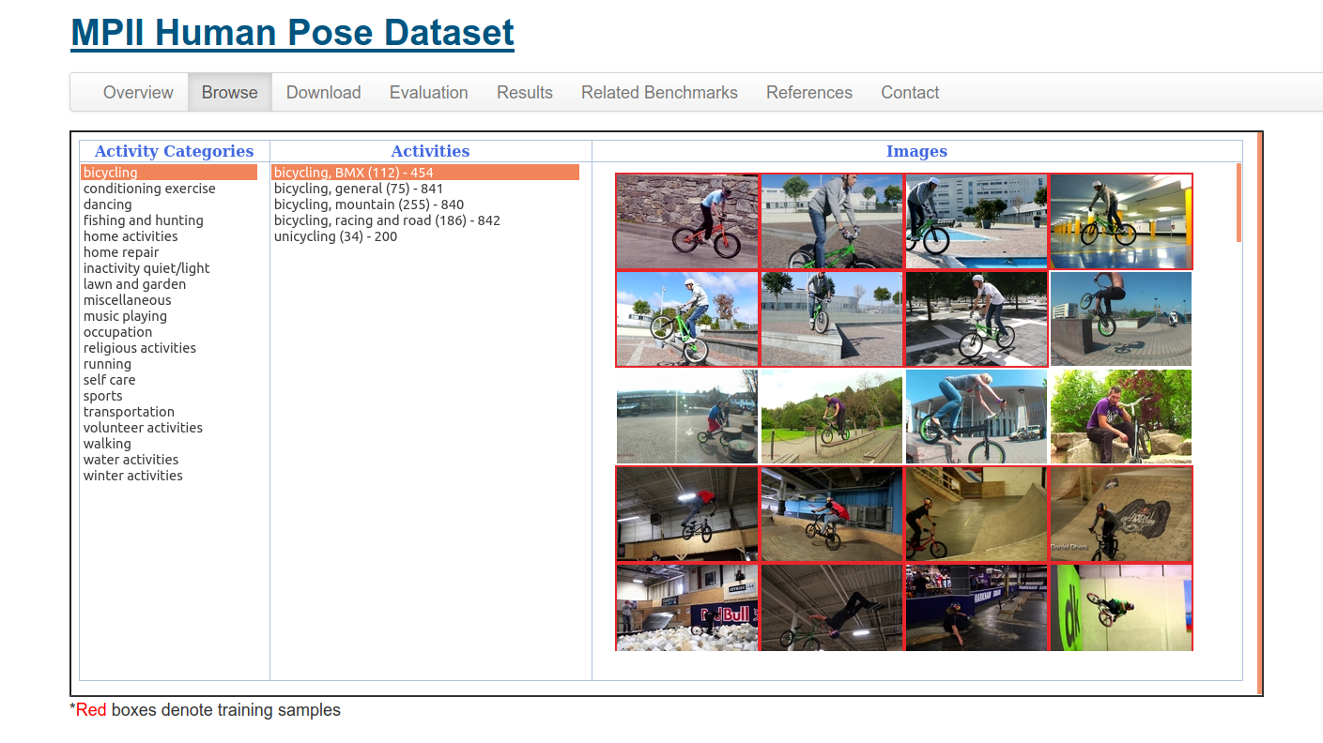
Data
We use the MPII Human Pose Dataset for the purposes of our study
The dataset is a state of the art benchmark for evaluation of articulated human pose estimation
The dataset includes 25000 images containing over 40000 people with annotated body joints.
The dataset has overall 20 activity categories spanning 410 human activities in total.

Slide 8
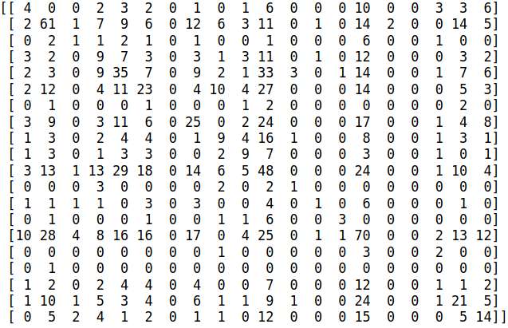
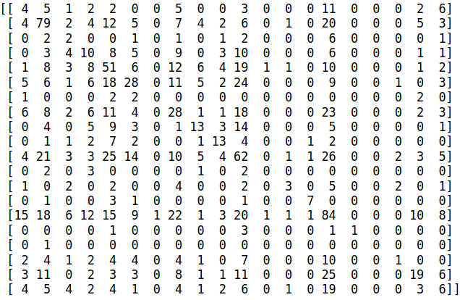
Results & Observations
Based on the study conducted, our observations for the classifiers were:
Accuracy:
Decision Trees: 0.239
SVM : 0.162
KNN: 0.294
Naive Bayes: 0.07
Furthermore, the confusion matrices for decision trees and KNN respectively are attached below.

Slide 9
Results & Observations
Looking carefully at the confusion matrices, we observe the the number of correct predictions made across the diagonal
In each of the activity records, we notice the number of correct predictions to be the highest in the record, with numbers going as high as 61 and 70 out of ~ 100 total images for that particular activity.
This was an extremely important observation confirming the hypothesis that joint data can indeed provide useful information pertaining to what activities are being performed.

Slide 10
Future Work
Due to server and time limitations, our entire approach was ended prematurely.
Based on our results, there is a lot of potential to further work on this study.
Use more expertly annotated datasets
Create a Convolutional Neural Network as a multilabel classifier for relating activity categories with joint annotations
Use image data superimposed with joint annotations and note improvement in accuracy.

